Slide 1
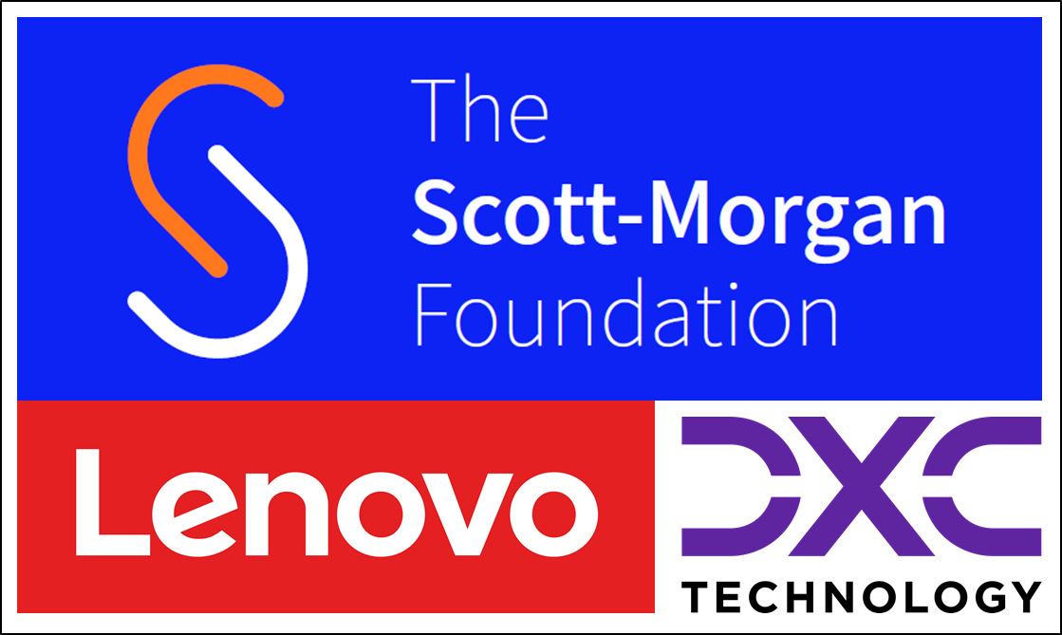
The Scott Morgan Foundation Technology Architecture Workshop 1
Steve Nicklin
DXC
September 29th & 30th 2021

Slide 2
Contents
Topic
Overview and Introductions | Jerry Overton, All
Plan | Steve Nicklin
Architectural Principles | Steve Nicklin
Fundamental Requirements | Steve Nicklin
Discussion | All

Slide 3
Overview and Introductions

Slide 4
Overview
Overview
Scott Morgan Foundation with Lenovo and DXC
On September 15th 2021 DXC Technology and Lenovo announced a collaboration with visionary robotics scientist Dr. Peter Scott-Morgan and his philanthropic foundation to develop ambitious assistive technology solutions by integrating the latest hardware, software, and artificial intelligence (AI) technologies to empower people with disabilities, illnesses, and other challenging conditions.
DXC and Lenovo – alongside a team of volunteers and leading technologists – will provide hardware, software support, integration, and artificial intelligence expertise. Key initiatives include:
Developing autonomous, self-driving wheelchairs to navigate homes and beyond;
Preserving personality with an avatar that renders quickly in photo-realistic detail;
Leveraging augmented reality (AR) as a user interface controlled with only eye movements;
Accelerating the generation and customization of emotionally expressive digital voices; and
Embedding smart technology throughout a family home to enhance the life of all its occupants.
DXC will act as technology integrator. Deploying capabilities from the Enterprise Technology Stack, DXC will bring technology know-how and experience to ensure seamless and secure integration across infrastructure, applications, analytics, and engineering solutions.
The first element that DXC is contributing is a an Architecture Platform for the Scott Morgan Foundation alongside a set of Architectural Principles that support the Platform. This document describes the process which will generate the first iteration of those two deliverables.

Slide 5
Introductions
Introductions
Who is on the call and what can they bring!
Tell us:
Your name
Your partner organisation
Any previous involvement with the Scott Morgan Foundation
What can you bring to the party!

Slide 6
Plan
Plan
What we are trying to achieve
The Foundation needs to define a Technical Architecture for the solutions that will support Peter and ultimately feed back out to the wider world. Once the Technical Architecture is agreed it will be published on the Foundation GitHub and be available to contributors to understand how they can plug their contributions into the eco-system
Stages
Pre-workshop Sessions
Architecture Workshop 1 – Focussing on Principles and Fundamentals ← THIS WORKSHOP
Architecture Workshop 3 – Architecture Design and Solutions
Rules for the Workshop
What is presented during the sessions is an ‘as-is’ current view constructed by Jerry, Logan and Steve with inputs from Sukhi. It is NOT cast in stone. Please challenge.
Every person’s view/opinion is equally valid. These sessions are a discussion exercise to tease out the latest thinking from the partners and contributers.
The Foundation will take on board all suggestions/recommendations and use them to build an Architecture based on consensus.
The decision of the Foundation is however final – the Foundation does withhold the right to override any decision made during these workshops.

Slide 7
Architectural Principles

Slide 8
Technical Architectural Principles #1
Principles
What are architectural principles and why do we need them?
1. Principles Are Easy To Socialize – Enterprise Architecture is about people. Organizational politics are one of the key inefficiencies in the architectural process. Principles are one tool in the architect's pocket that can breakdown political barriers and get everyone aligned behind an architectural approach. Principles are concise, actionable and catchy.
2. Principles Stabilize – Like the Constitution of the United States or any democratic government — principles should be enduring statements that are difficult to change. This protects the architecture from wild swings based on the organizational politics of the day.
3. Principles Make You Smarter – What are your key architectural decisions based upon? Social dynamics (the outcome of a meeting)? The whims of an architect? You can do much worse than basing your architectural decisions on a set of principles.
4. Principles Make Governance Less Terrible – It's no fun to be governed when there are no laws on the books. It's unfair to judge a project's architecture without first communicating the principles and roadmap of your Enterprise Architecture.
5. Principles Sell – Your business likely views IT as an irrational ball of mud. When your business asks you where your architecture is headed — principles are one thing everyone in IT can point to.
6. Principles Help You Ship – An organization that is confused about its core values and direction is as organization that will make slow decisions.
7. Principles Drive Metrics – Looking for some Enterprise Architecture governance metrics? Start evaluating projects against a set of principles — it's a great source of EA metrics.
From https://arch.simplicable.com/arch/new/7-reasons-you-need-architecture-principles

Slide 9
Technical Architectural Principles #2
Principles
Proposed Foundation Architectural Principles
The Foundation has a primary aspiration to great solutions which are accessible to all – from a hardware and software perspective this drives two principles which are entirely related to solution cost:
Wherever possible all software should be open source OR attracts an affordable license fee OR created by the Foundation with appropriate free-to-use licenses (this includes any COTS products declared free to use by the vendor) THIS NEEDS TO BE REVISITED IN THE CONTEXT OF API’S and REPLACEABILITY/PLUGGABILITY
Wherever possible all hardware used should be of commodity class – i.e. off-the-shelf non-bespoke hardware – unless there are significant restrictions (e.g. regulatory, safety related or simply uniqueness) which would prevent this REVIST DURING FORMAL REVIEW
Wherever possible the Foundation would like all solutions to capture ALL data they recorded or generated for future observability (AI, M/L, analytics) reasons.
All solutions must be capable of integration into a Microservices architecture that utilises a distributed event driven architecture/implementation using non-proprietary interfaces/integration languages
All real-time mission critical related features must be able to offer in a graceful degraded manner ‘off grid’ i.e. not connected to the internet.
Any solution which needs to persist data onward for non-real-time AI, analysis and M/L must implement a store-and-forward solution which will allow data captured/generated to be synchronised on the occasions it is connected to the internet ‘after the data capture/generate events’
Wherever a solution provides Mission Critical Support to Peter Scott-Morgan then this shall be required to meet Non-Functional Requirements that reflect this status – i.e. solutions which provide critical health related functions must be ‘Non-Stop’ rated. This mandates the following: No Single Points of Failure, and very short RTO (RPO is very much less critical) if appropriate.
The Foundation already has a number of solutions created for Peter Scott-Morgan which provide him with technical solutions to the challenges that MND brings to his life – the Foundation is keen that these are not ‘thrown away’ in pursuit of architectural ideals, it prefers that these be ‘refactored/integrated’ wherever possible and only retired when there are solutions tested and available which ‘completely replace’ relevant existing systems.
Wherever possible the Foundation expects that data processing should take place wherever is most appropriate in terms of compute and storage capability e.g. It may not be appropriate (legally or capacity wise) to store all the video used in real-time facial analysis, a better solution could be to save a photo snapshot tagged with the faces identified
Any solution (e.g. sensor or microservice) must be able to be simulated in a testbed and research environments
Every solution must adhere to automated system compliance testing and must provide its own automated functional and non-functional compliance tests
Every solution must be able to be (buildable from???) distributed onto the Foundation GitHub (???including contextual content around items)
??? Add Safety related principles

Slide 10
Fundamental Requirements

Slide 11
Fundamental Requirements #1
Fundamentals
UML Diagrams
The Foundation has produced a number of UML diagrams which reflect its current thinking – these are available in the Foundation GitHub but will be presented here for discussion
Refer to the following diagrams
Scenarios / Actors
Scenarios / Scenarios
Scenarios / Logical View
??? Jerry to send updated list ???

Slide 12
Fundamental Requirements #2
Fundamentals
What are the key concepts/requirements that the Foundation needs to define an Architecture for
Communication
the solution must provide Peter with the means to be able to talk and express himself
the solution must provide Peter with the means to command and/or request support from external solutions
the solution must provide Peter with a “bullet proof” way to call for help in any situation
Health
the solution must provide monitoring and intervention capabilities in respect of Peter’s health, life support systems and surrounding environment
the solution must be able to identify, react and respond in real-time to significant health related issues
Mobility
The solution must be able to support the independent and/or autonomous movement of Peter and his wheelchair around Highcliff and other places without manual intervention from Peter’s care team
Artificial Intelligence
The solution must support the augmentation of any/all of the above with Artificial Intelligence to improve the responsiveness/functionality of the functionality
??? Await Jerry decision on this slight ???

Slide 13
Fundamental Requirements #3
Fundamentals
Justification for options to achieve the concepts described in the prior section
Requirement | Consequence
Given the need for real-time responsiveness combined with the need to support interaction and integration between the many different componets that will make up the solution over time there is a clear need for a Real Time Messaging Core at the heart of the solution. | Real Time Event Based Messaging Core
Large amounts of data will be being received and processed by the system – this will be arriving from a myriad of source systems and could arrive in very large quantities. Whilst useful for analysis using AI and M/L, on its own this will not map directly to ‘meaning’ or ‘events’ that matter to Peter. There will be the need to support higher levels of messaging which match these ‘higher level’ events. | The Messaging Core must be able to support both raw data and event data.
It is likely that the design and delivery of the solution will be achieved by a number of parties all working individually on elements of the solution, each of which will interact with the messaging core | Microservice Architecture
There is a requirement to capture and store for future analysis very large amounts of data as it is received from Peter, his Wheelchair, Highcliff and any number of other data sources which have a relationship with Peter | A flexible and scalable database architecture will be required to support this

Slide 14
Final Discussion
Discussion
End of Session Round Up
Recap Major Decisions
Recap Actions Taken
Session 2 will look closer into the actual Technology Solutions we need to define
What worked well?
What didn’t work so well?

